Slide 1
Database Designer
By: Rahul Tailor & Kiran Hart

Slide 2
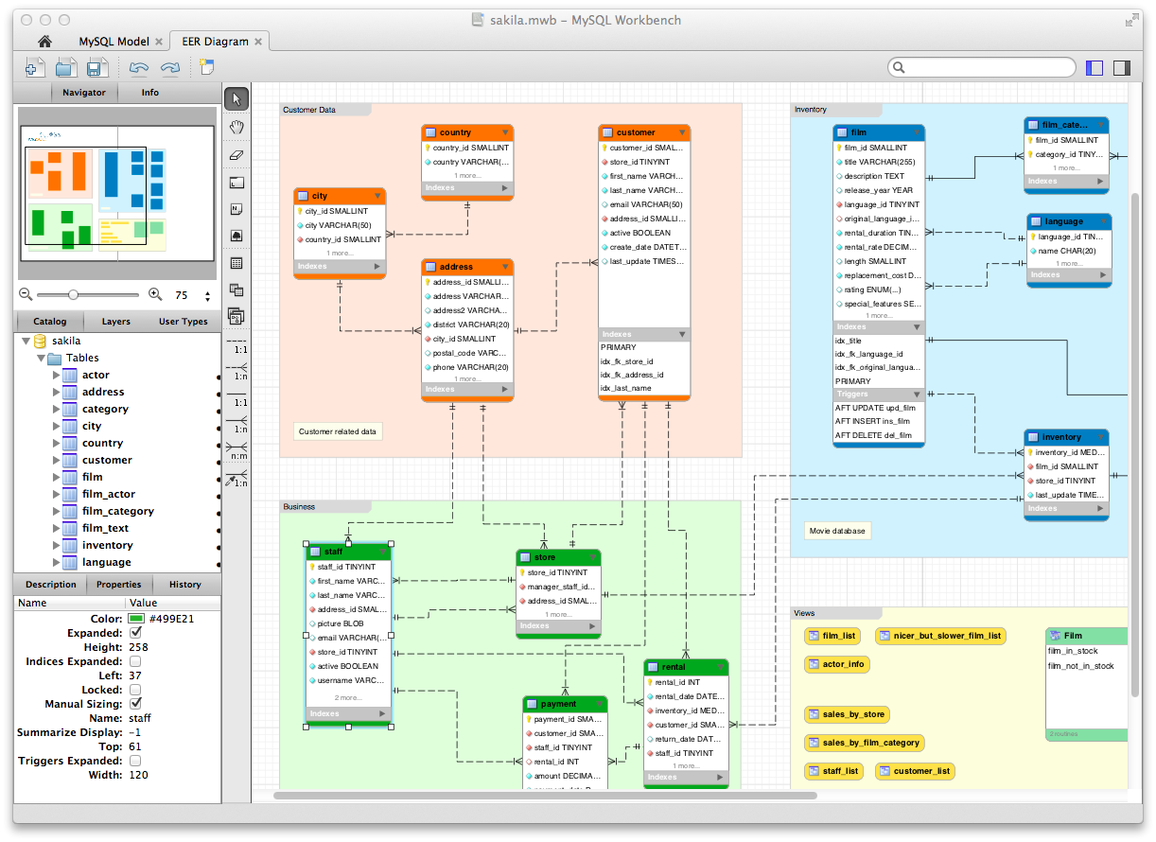
What the career is about?
Database design is the organisation of data according to a database model. The designer determines what data must be stored and how the data elements interrelate. With this information, that can begin to fit the data to the database model.
They are most tight on deadlines and under pressure. They also use problem-solving and good analytical skills, communication, teamwork and negotiation skills.

Slide 3
Career Opportunities

Slide 4
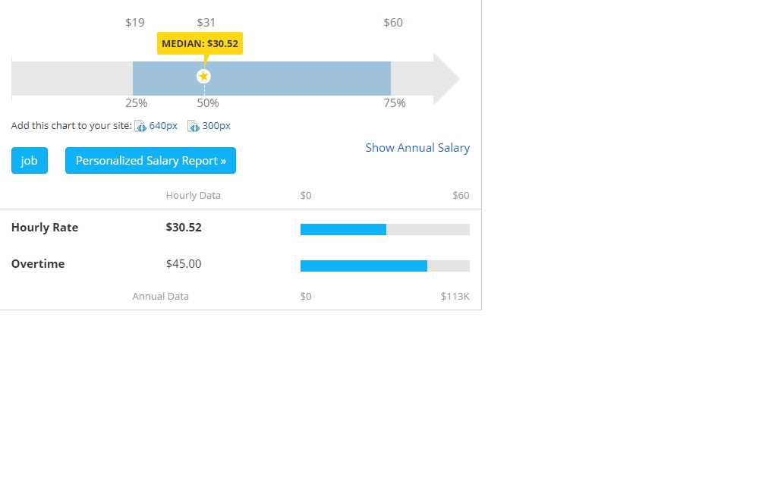
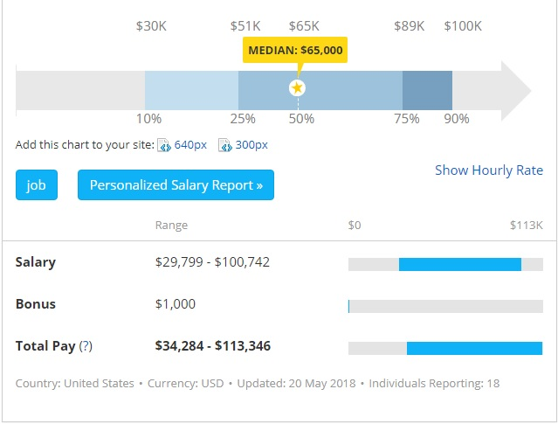
Hourly Rate
Total Salary

Slide 5


Slide 6
Technology Connections
The type of computer are used for this career pathway is DBMSs like Oracle, MS SQL Server, DB2 and MySQL support this model. Other traditional models, such as hierarchical data models and network data models, are still used in industry mainly on mainframe platforms.

Slide 7




Computer Languages / Environments
MySQL
SQLite
Java
C#
Python
PHP
PHPMyAdmin
Amazon Web Services
Redis
Or any machine that runs some sort of database

Slide 8
Program Requirements
You will mainly need computer science / programming credits, any other related credits like computer engineering, math, etc could help.
Skills you should have
Analytical skills; you’ll need to understand complex instructions.
Concentration; you may spend hours on end writing lines of code
Detailed oriented; one small mistake can mess everything up
Troubleshooting skills; You’ll also need to check and fix errors in new/old code.

Slide 9


College Programs
Seneca
Humber
Robertson
Database Application Developer
SQL Server Database Development
Software & Database Developer

